Slide 1
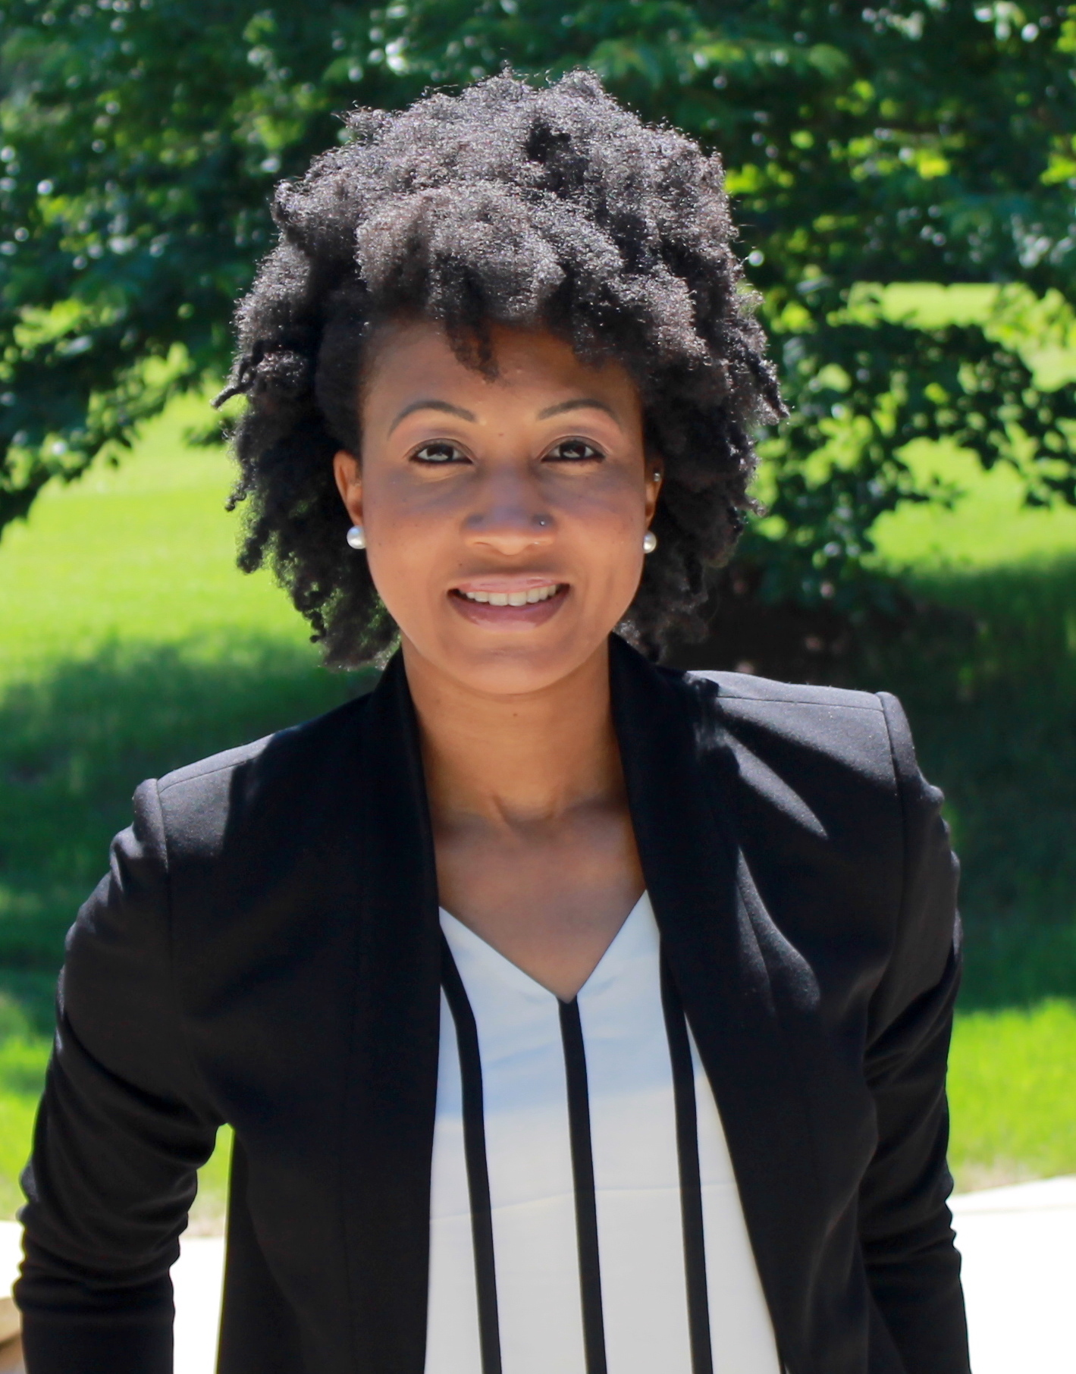
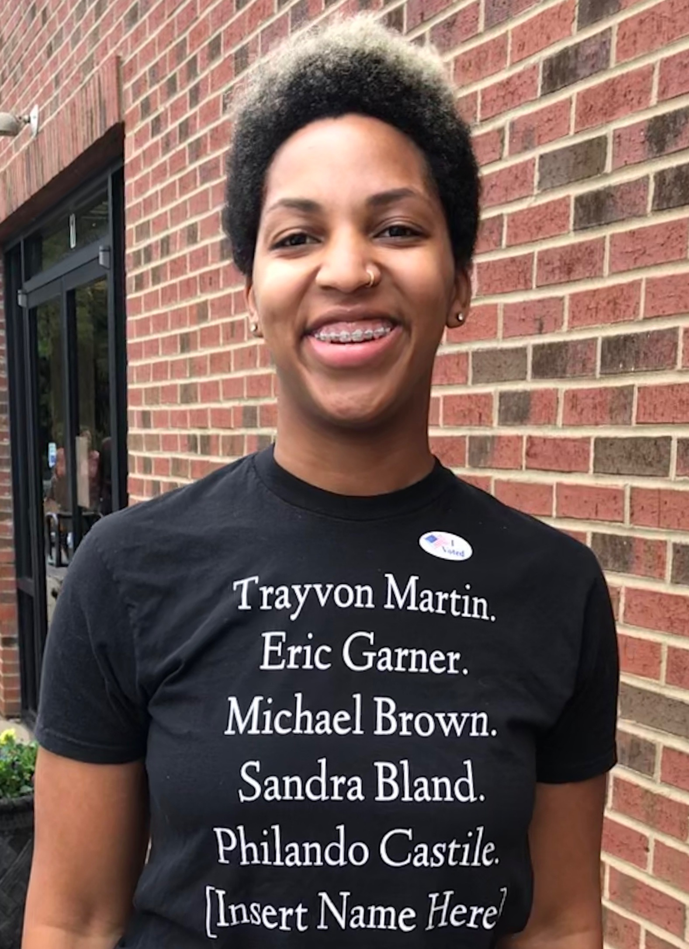
Liz Styron
Program Manager YES! Faith Initiatives
Kaleia Martin
Sr. Program Coordinator
Environmental Justice
Walk It Like You Talk It:
Youth Empowerment & Racial Equity

Slide 2
5 Reasons Why
YOUTH EMPOWERMENT DOESN’T WORK WITHOUT RACIAL EQUITY

Slide 3
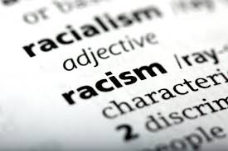
Before We Dive In...
Context is Key!
#YES4Change
Before talk about racial equity, we should provide our definition of Racism:
= Racial Prejudice + Social & Institutional Power
= A system of ADVANTAGE based on race
= A system of OPPRESSION based on race
= A white supremacy system supported and dependent on an all-class collaboration called White to end cross-racial labor solidarity
*Definition provided by the Racial Equity Institute, based in Greensboro, North Carolina*

Slide 4
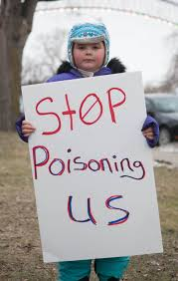
1. Death by Racism.
Our young people are dying, both literally and figuratively...
Notes:
Although young people under the age of 18 make up more than a quarter of the U.S. population, their potential to contribute to societal change is systematically ignored. Our nation is suffering economically, spiritually, creatively and civilly as a result. By the end of the decade the majority of the US population under 18 will be people of color.
Our potential to create community change is significantly decreased when young lives are being unjustly cut short and not allowed to fulfill their optimal health and safety. Our training reinforced that racial equity means improved outcomes for all (not predicted by race) and that communities are more likely to thrive in an equitable society.
Revolution (social change) is not top-down. It starts from the bottom, the most marginalized, those historically and systematically oppressed.

Slide 5
2. It’s Urgent.
Youth leadership is critical and their critical awareness must be comprehensive.
Notes:
Although young people under the age of 18 make up more than a quarter of the U.S. population, their potential to contribute to societal change is systematically ignored. Our nation is suffering economically, spiritually, creatively and civilly as a result. By the end of the decade the majority of the US population under 18 will be people of color.
Our potential to create community change is significantly decreased when young lives are being unjustly cut short and not allowed to fulfill their optimal health and safety. Our training reinforced that racial equity means improved outcomes for all (not predicted by race) and that communities are more likely to thrive in an equitable society.
Revolution (social change) is not top-down. It starts from the bottom, the most marginalized, those historically and systematically oppressed.

Slide 6
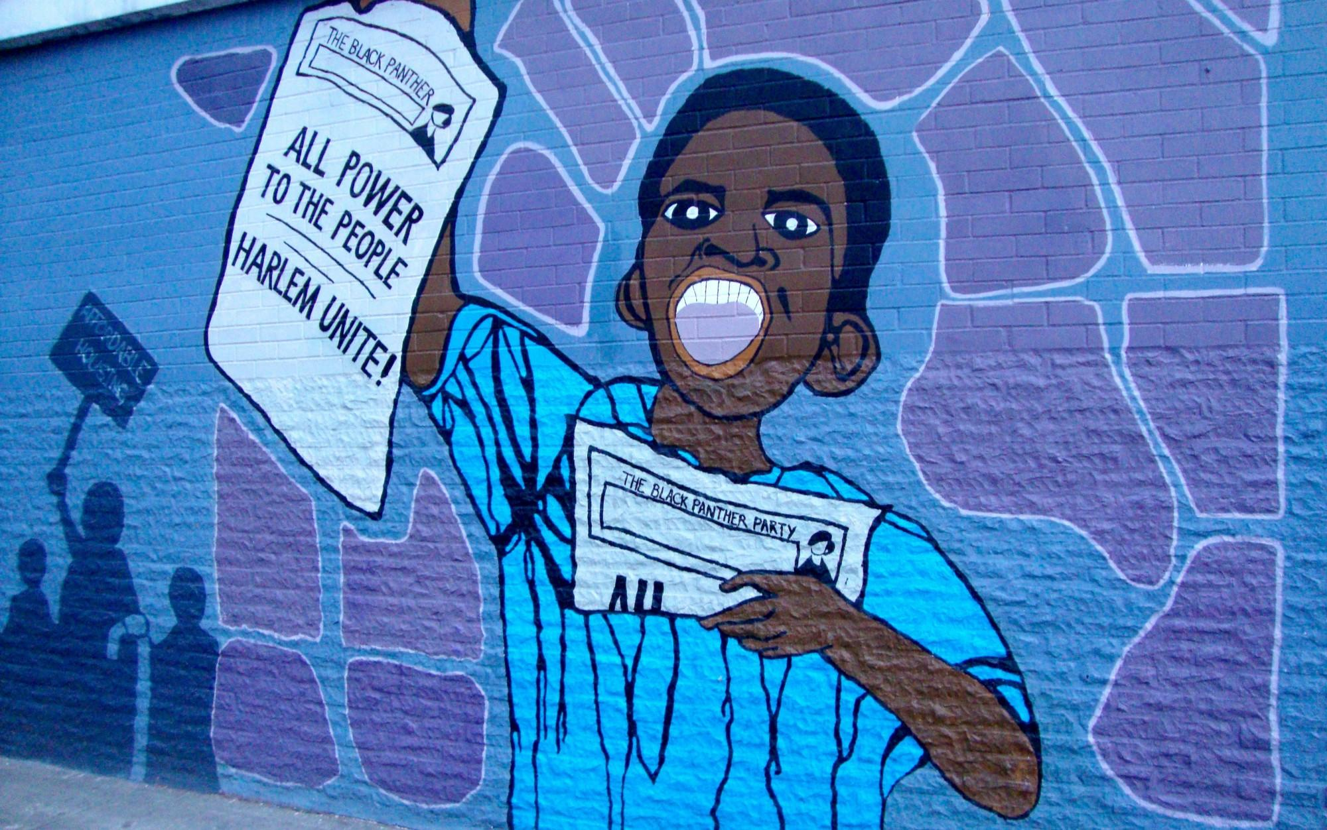
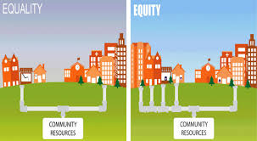
3. Youth Demand It.
Young people know something is off balance...
Unequal resources + Unequal opportunities = Unequal outcomes
Notes:
Although young people under the age of 18 make up more than a quarter of the U.S. population, their potential to contribute to societal change is systematically ignored. Our nation is suffering economically, spiritually, creatively and civilly as a result. By the end of the decade the majority of the US population under 18 will be people of color.
Our potential to create community change is significantly decreased when young lives are being unjustly cut short and not allowed to fulfill their optimal health and safety. Our training reinforced that racial equity means improved outcomes for all (not predicted by race) and that communities are more likely to thrive in an equitable society.
Revolution (social change) is not top-down. It starts from the bottom, the most marginalized, those historically and systematically oppressed.

Slide 7
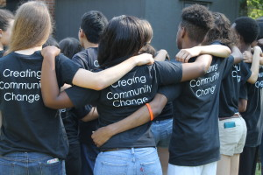
4. Our Mission Depends on it.
YES! supports the power of youth to challenge injustice and advocate for community transformation. Through intentional youth/adult partnerships, we learn, unlearn, create, dream, and grow together.
“racism saps the strength of the whole society through the waste of human resources.”
Dr. Camara P. Jones
Notes:
Although young people under the age of 18 make up more than a quarter of the U.S. population, their potential to contribute to societal change is systematically ignored. Our nation is suffering economically, spiritually, creatively and civilly as a result. By the end of the decade the majority of the US population under 18 will be people of color.
Our potential to create community change is significantly decreased when young lives are being unjustly cut short and not allowed to fulfill their optimal health and safety. Our training reinforced that racial equity means improved outcomes for all (not predicted by race) and that communities are more likely to thrive in an equitable society.
Revolution (social change) is not top-down. It starts from the bottom, the most marginalized, those historically and systematically oppressed.

Slide 8
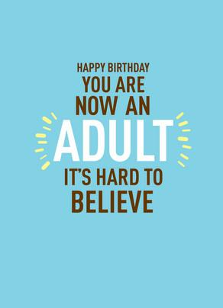
5. Power IS NOT Balanced.
Young people don’t know enough to be taken seriously.
Young people need to be kept under control until the magical age of adulthood.
Notes:
Racism operates in a way that maintains the same unjust power structure that suppresses youth voices. For youth of color, this issue is magnified by the fact that the racial composition of government and non-profit leadership too often does not reflect the communities they are elected or appointed to serve. Empowering youth of color and addressing structural racism elevates the voices of marginalized communities and helps us begin to realize a more balanced power structure.
Young people’s thoughts and feelings are often overlooked, undermined, or included as a token without being given meaningful weight or consideration. While age certainly brings with it more experience, it does not necessarily bring wisdom, nor does a lack of life experience preclude insight. There are various consequences of relying on an authoritarian, top-down model which assumes that 1. young people do not know enough to be taken seriously, and 2. they need to be “kept under control” until they reach the magical age of adulthood. By lumping young people together, we generalize and fail to offer care that is appropriate, assuming needs instead of getting to know and listening to individuals.
By telling young people what to think and do instead of including them in conversation, we undermine young people’s feelings and intuition, which in turn discourages critical thinking, emotional intelligence, and introspection.
By enforcing lower standards of behaviour for adults than children, we communicate that there are different standards for older and physically stronger people, which means that younger, smaller people can be treated with less respect and bodily autonomy. We teach that there are contexts in which their agency matters less.
In sum, failing to recognize young people as already being full, autonomous persons provides a poor foundation for youth to take initiative, assert themselves when they feel uncomfortable, and speak up against unjust authority.

Slide 9
A “Seat at the Table” Starter Kit:
What Adults Need to Know….
Who is/is not at the table?
Get to know the youth at the table.
When, where and how is the table created?
What happens when youth want to stand on the table?
Provide youth the tools to create their own table.
What does shared power look like at the table?
Notes:
Equitable Recruitment practices
There is no substitute for building personal relationships (avoids tokenism, manipulation)
Internal organization policies and practices (white dominant culture to liberated work space)
How do you handle youth autonomy? When youth do to you what you have trained them to do to others? Challenge
Caucusing is important. Builds a practice of truth tellings, vulnerability, and courageous conversations
This is the ultimate question. Are youth on the board?

Slide 10
Thank You!!
Kaleia Martin
Sr. Program Coordinator l Env. Justice
Kaleia@youthempoweredsolutions.org
Liz Styron
Program Manager l YES! Faith Initiatives
Liz@youthempoweredsolutions.org

